Slide 1
Database Design
Databases Systems [BS-IV(cs/se)] [Spring 2022]
Muhammad Hussain Mughal
Most of the content was taken from slides of book “Database System Concepts, 7th Ed, Silberschatz, Korth and Sudarshan”

Slide 2
Database Design – 3 levels
Conceptual Design
Logical Design
Transforming ERD to relational Model: tables, keys (constraints), etc
Physical Design
Creating database, physical tables and other database objects based on specific DBMS
Creating an Entity Relationship Diagram (ERD) to represent the reality and capture business data requirements

Slide 3
Design Approaches
Entity Relationship Model
Models an enterprise as a collection of entities and relationships
Entity: a “thing” or “object” in the enterprise that is distinguishable from other objects
Described by a set of attributes
Relationship: an association among several entities
Represented diagrammatically by an entity-relationship diagram:
Normalization Theory
Formalize what designs are bad, and test for them

Slide 4
ER model -- Database Modeling
The ER data mode was developed to facilitate database design by allowing specification of an enterprise schema that represents the overall logical structure of a database.
The ER model is very useful in mapping the meanings and interactions of real-world enterprises onto a conceptual schema. Because of this usefulness, many database-design tools draw on concepts from the ER model.
The ER data model employs three basic concepts:
entity sets,
relationship sets,
attributes.
The ER model also has an associated diagrammatic representation, the ER diagram, which can express the overall logical structure of a database graphically.

Slide 5
Entity Sets
An entity is an object that exists and is distinguishable from other objects.
Example: specific person, company, event, plant
An entity set is a set of entities of the same type that share the same properties.
Example: set of all persons, companies, trees, holidays
An entity is represented by a set of attributes; i.e., descriptive properties possessed by all members of an entity set.
Example:
instructor = (ID, name, street, city, salary ) course= (course_id, title, credits)
A subset of the attributes form a primary key of the entity set; i.e., uniquely identifying each member of the set.

Slide 6
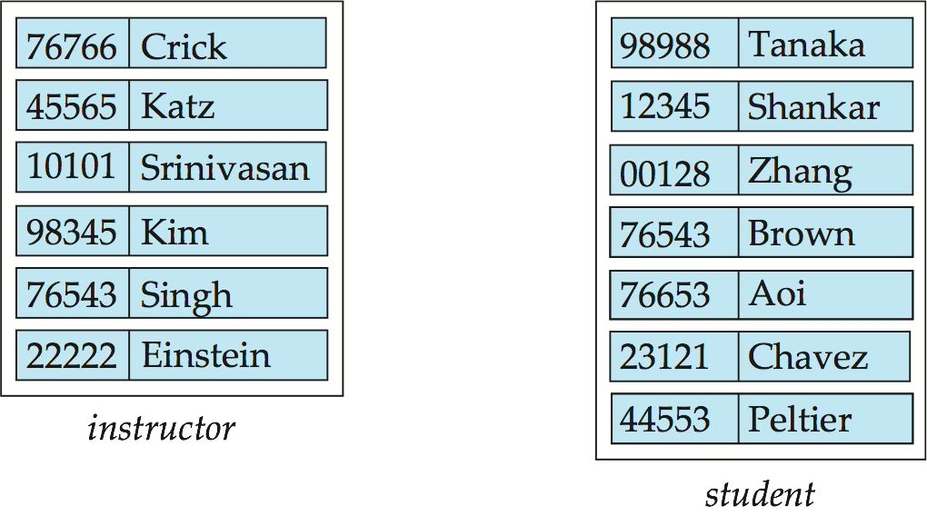
Entity Sets -- instructor and student
instructor_ID instructor_name student-ID student_name

Slide 7
Relationship Sets
A relationship is an association among several entities
Example: 44553 (Peltier) advisor 22222 (Einstein) student entity relationship set instructor entity
A relationship set is a mathematical relation among n ≥ 2 entities, each taken from entity sets
{(e₁, e₂, … e_{n}) | e₁ ∈ E₁, e₂ ∈ E₂, …, e_{n} ∈ E_{n}} where (e₁, e₂, …, e_{n}) is a relationship
Example:
(44553,22222) ∈ advisor

Slide 8
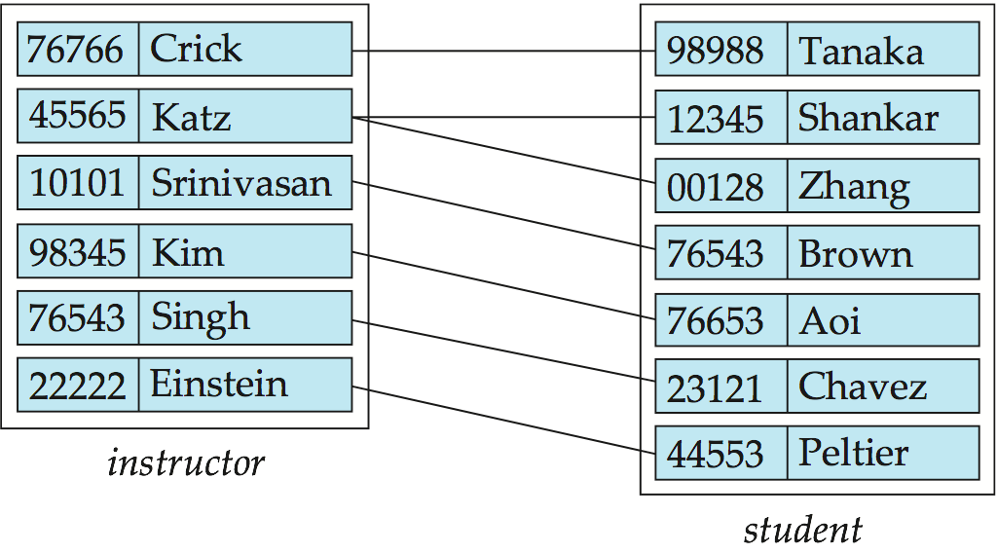
Relationship Set advisor

Slide 9
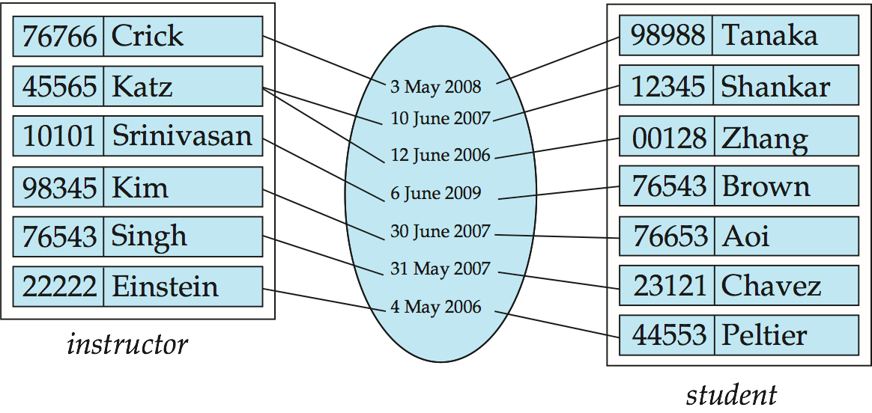
Relationship Sets (Cont.)
An attribute can also be associated with a relationship set.
For instance, the advisor relationship set between entity sets instructor and student may have the attribute date which tracks when the student started being associated with the advisor

Slide 10
Degree of a Relationship Set
binary relationship
involve two entity sets (or degree two).
most relationship sets in a database system are binary.
Relationships between more than two entity sets are rare. Most relationships are binary.
Example: students work on research projects under the guidance of an instructor.
relationship proj_guide is a ternary relationship between instructor, student, and project

Slide 11
Mapping Cardinality Constraints
Express the number of entities to which another entity can be associated via a relationship set.
Most useful in describing binary relationship sets.
For a binary relationship set the mapping cardinality must be one of the following types:
One to one
One to many
Many to one
Many to many

Slide 12
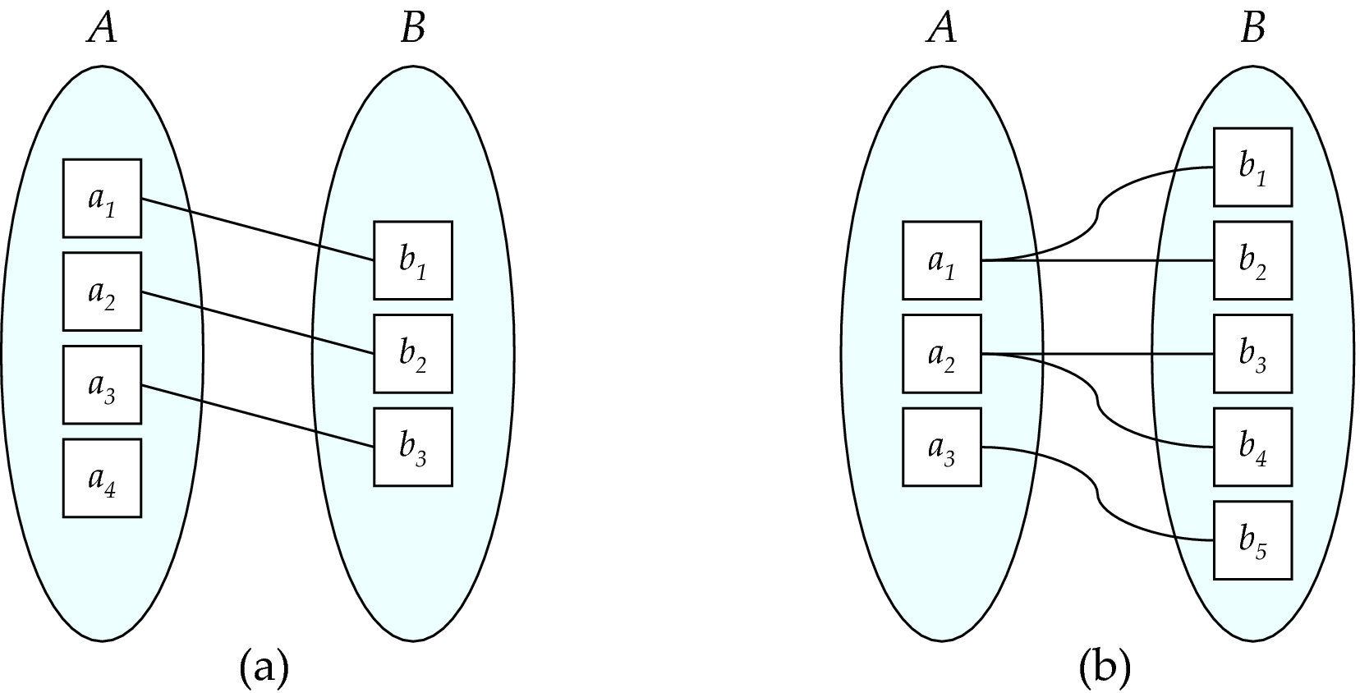
Mapping Cardinalities
One to one
One to many
Note: Some elements in A and B may not be mapped to any elements in the other set

Slide 13
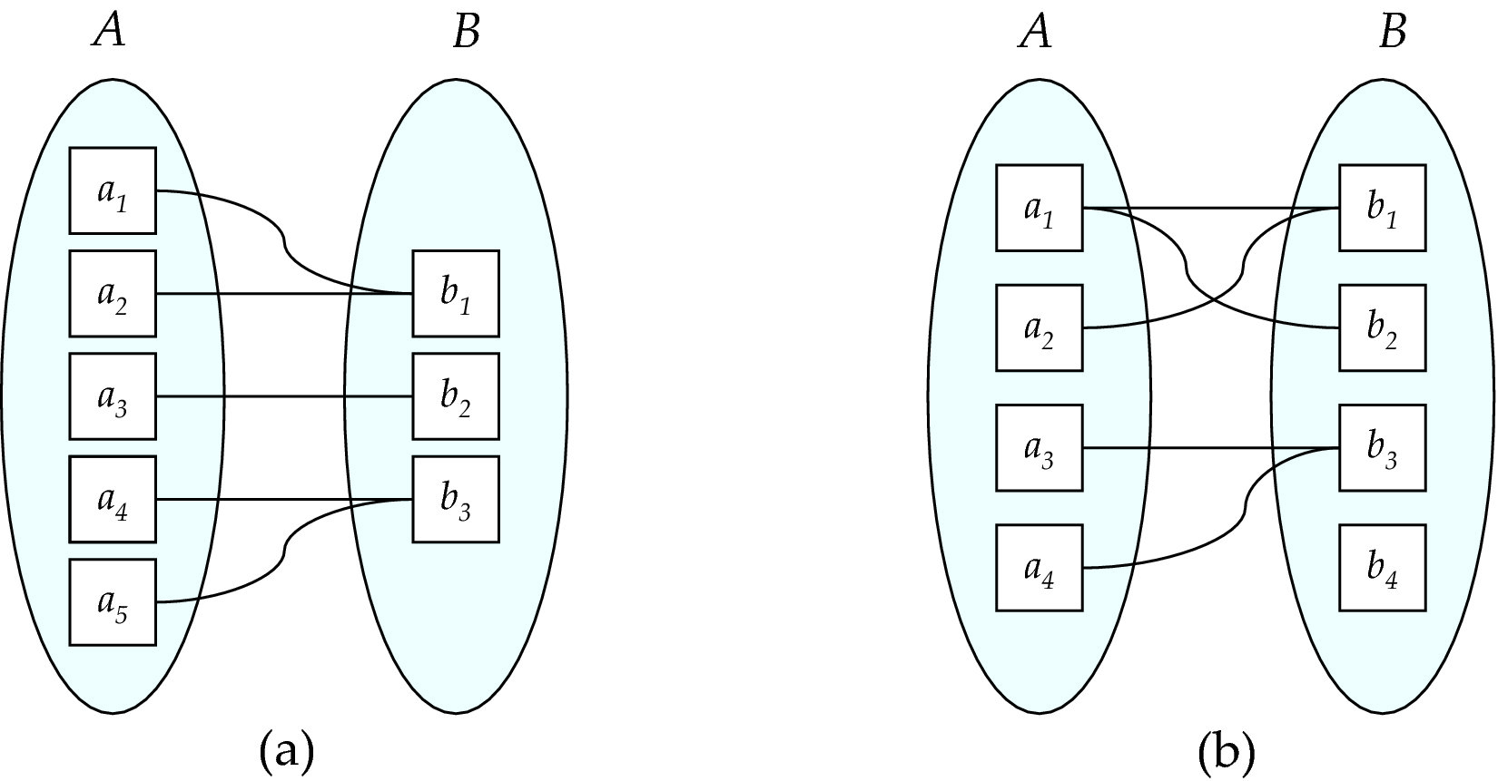
Mapping Cardinalities
Many to one
Many to many
Note: Some elements in A and B may not be mapped to any elements in the other set

Slide 14
Complex Attributes
Attribute types:
Simple and composite attributes.
Single-valued and multivalued attributes
Example: multivalued attribute: phone_numbers
Derived attributes
Can be computed from other attributes
Example: age, given date_of_birth
Domain – the set of permitted values for each attribute

Slide 15
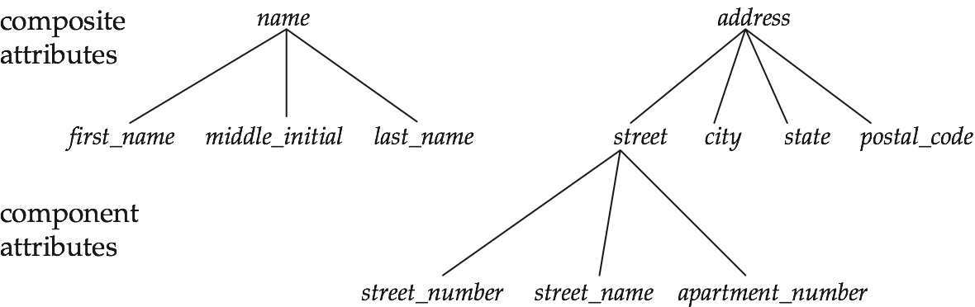
Composite Attributes

Slide 16
Weak Entity Sets
Consider a section entity, which is uniquely identified by a course_id, semester, year, and sec_id.
Clearly, section entities are related to course entities. Suppose we create a relationship set sec_course between entity sets section and course.
Note that the information in sec_course is redundant, since section already has an attribute course_id, which identifies the course with which the section is related.
One option to deal with this redundancy is to get rid of the relationship sec_course; however, by doing so the relationship between section and course becomes implicit in an attribute, which is not desirable.

Slide 17
Weak Entity Sets (Cont.)
An alternative way to deal with this redundancy is to not store the attribute course_id in the section entity and to only store the remaining attributes section_id, year, and semester. However, the entity set section then does not have enough attributes to identify a particular section entity uniquely; although each section entity is distinct, sections for different courses may share the same section_id, year, and semester.
To deal with this problem, we treat the relationship sec_course as a special relationship that provides extra information, in this case, the course_id, required to identify section entities uniquely.
The notion of weak entity set formalizes the above intuition. A weak entity set is one whose existence is dependent on another entity, called its identifying entity; instead of associating a primary key with a weak entity, we use the identifying entity, along with extra attributes called discriminator to uniquely identify a weak entity. An entity set that is not a weak entity set is termed a strong entity set.

Slide 18
Weak Entity Sets (Cont.)
Every weak entity must be associated with an identifying entity; that is, the weak entity set is said to be existence dependent on the identifying entity set. The identifying entity set is said to own the weak entity set that it identifies. The relationship associating the weak entity set with the identifying entity set is called the identifying relationship
Note that the relational schema we eventually create from the entity set section does have the attribute course_id, for reasons that will become clear later, even though we have dropped the attribute course_id from the entity set section.

Slide 19
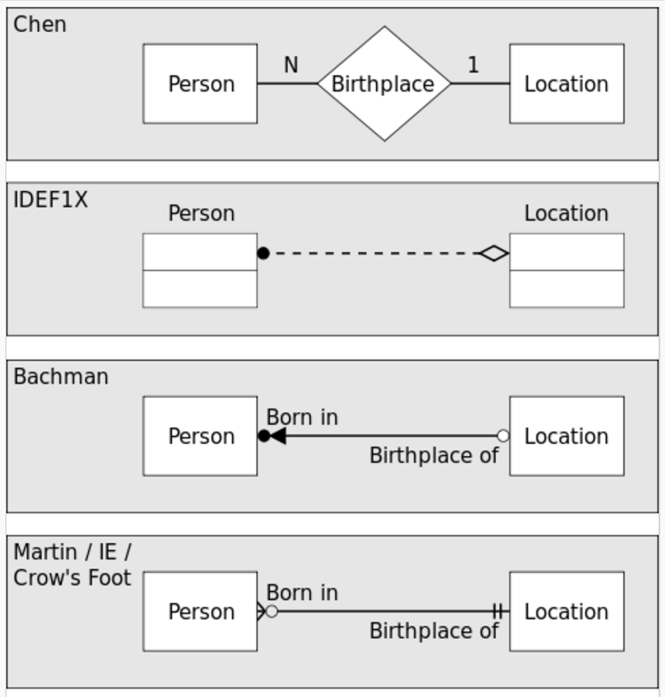
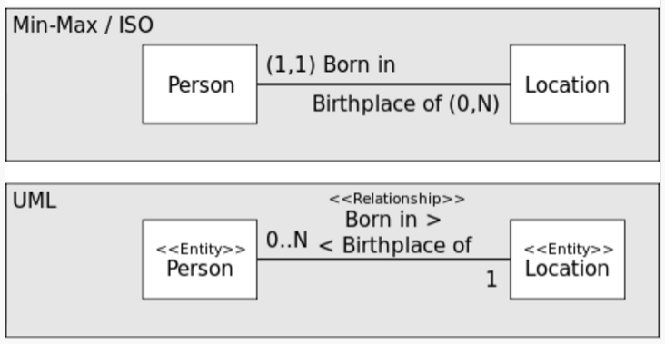
Popular Notations

Slide 20
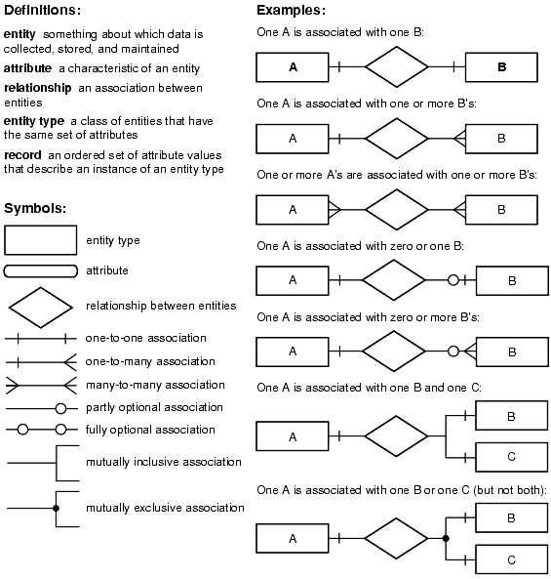

Slide 21
E-R Diagrams - Chen’s notation
Entity–relationship modeling was developed for database and design by Peter Chen and published in a 1976
https://www.youtube.com/watch?v=5OxZRj26uDE

Slide 22
E-R Diagrams - Chen’s notation
Entity Set
Weak Entity Set
Attribute
Example

Slide 23
E-R Diagrams - Chen’s notation
Key
Multivalued Attribute
Drived Attribute

Slide 24
E-R Diagrams - Chen’s notation
Composite Attribute

Slide 25
E-R Diagrams - Chen’s notation – Relationship
Strong Relationship
Weak (identifying) Relationship

Slide 26
E-R Diagrams - Chen’s notation – Relationship
Cardinality
one-to-one (1:1)
one-to-many (1:N)
many-to-many (M:N)

Slide 27
E-R Diagrams - Chen’s notation – Relationship
Participation
Total
Partial

Slide 28
E-R Diagrams - Chen’s notation
Example
Employee
Department

Slide 29
E-R Diagrams - Chen’s notation – Exercise
Example
A salesperson may manage many other salespeople. A salesperson is managed by only one salespeople. A salesperson can be an agent for many customers. A customer is managed by one salespeople. A customer can place many orders. An order can be placed by one customer. An order include many inventory products. An inventory product may be listed on many orders. An inventory product is assembled from many parts. A part may be assembled into many inventory product. Many employees assemble an inventory product from many parts. A supplier supplies many parts. A part may be supplied by many suppliers

Slide 30
E-R Diagrams - Chen’s notation – Exercise
Example 2
A publishing company produces books on various subjects. The books are written by authors who specialize in one particular subject. The company employs editors who, not necessarily being specialist in a particular area, each take sole responsibility for editing one or more items for publications. Every book requires some items for publication. These items supplied by suppliers. One supplier can supply many items. Shop owner buys books from the publisher. Shop owner can buy many books but one book can be bought by one shop owner. Books are uniquely identified by Bookid.

Slide 31
E-R Diagrams - Chen’s notation – Exercise
Example 3
ERD for DreamHome Use Case

Slide 32
Professors have an SSN, a name, an age, a rank, and a research specialty.
Projects have a project number, a sponsor name (e.g., NSF), a starting date, an ending date, and a budget.
Graduate students have an SSN, a name, an age, and a degree program (e.g., M.S. or Ph.D.).
Each project is managed by one professor (known as the project’s principal investigator).
Each project is worked on by one or more professors (known as the project’s co-investigators).
Professors can manage and/or work on multiple projects.
Each project is worked on by one or more graduate students (known as the project’s research assistants).
When graduate students work on a project, a professor must supervise their work on the project. Graduate students can work on multiple projects, in which case they will have a (potentially different) supervisor for each one.
Departments have a department number, a department name, and a main office.
Departments have a professor (known as the chairman) who runs the department.
Professors work in one or more departments, and for each department that they work in, a time percentage is associated with their job.
Graduate students have one major department in which they are working on their degree.
Each graduate student has another, more senior graduate student (known as a student advisor) who advises him or her on what courses to take.

Slide 33
A manufacturing company produces products.
The following product information is stored: product name, product ID and quantity on hand.
These products are made up of many components. Each component can be supplied by one or more suppliers. The following component information is kept: component ID, name, description, suppliers who supply them, and products in which they are used.
Create an ERD to show how you would track this information.
Show entity names, primary keys, attributes for each entity, relationships between the entities and cardinality.
ASSUMPTIONS
A supplier can exist without providing components.
A component does not have to be associated with a product. Not all components are used in products.
A product cannot exist without components.

